Slide 1
York Region Crime Analysis: A Data-Driven Plan for 2026
An Analysis of Crime Trends to Inform Proactive Policing and Resource Strategy
Fuxi Ma
Notes:
This comprehensive presentation provides detailed analysis of crime patterns in York Region from 2020-2025, with advanced forecasting through 2027. Based on 299,984 crime records, we identify key trends, temporal patterns, predictive insights, and strategic recommendations for law enforcement and community safety initiatives.

Slide 2
Executive Summary
! District 4 (Vaughan) is in a state of chronic operational crisis, with 54% effective staffing, making it the epicenter of an 89.5% crime surge driven by organized crime and gun violence. This demands an immediate, targeted resource surge
Data
Nearly Half a Million Service Calls
29,388 staff overtime /shortage records
Crime data (2016–present)
Risk factor data: traffic, geographic, demographic, economic, weather, unemployment, youth population
Solution
Develop strategic plan to address the unprecedented 2024 crime surge while stabilizing long-term trends
Notes:
Executive summary highlighting CORRECTED temporal findings. Analysis confirms midnight (0:00) as the peak crime hour with 28,510 incidents. Critical issues include the 2024 crime spike requiring investigation, District 4's emergency situation with 544% growth, and the dominance of property crimes. The forecast indicates a positive trend with continued decline through 2027, providing opportunity for targeted interventions.

Slide 3
Table of Contents
Crime Data Overview
2024 Anomaly & High-Risk Zones
Peak of 95,050 crimes in 2024
Integrated data from 299,984 crime data records, 476k+ service calls, and staffing records
Crime Trends & Forecasting (2025-2027)
Forecasting model with 2024 outlier excluded
Strategic outlook and implications of the post-2024 decline
District-Level Priority Assessment
Full breakdown of all district risk scores and priorities
District 1 faces chronic, high-volume challenges, but District 4 (Vaughan) requires immediate intervention
Spotlight on District 4 (Vaughan)
High-risk days patterns
Strategic Recommendations
Emergency response, prevention, and resource optimization plans
Conclusion
Strategic priorities and immediate next steps
Notes:
Good morning. I'm here to present our York Region Crime Analysis. To summarize our key findings upfront: we analyzed nearly 300,000 records and identified a major spike in 2024, with over 95,000 crimes—an 89.5% increase. However, we are seeing a strong correction in 2025. Property crime is the dominant category, and our highest risk area is District 1 in the North. Now, let me walk you through how we reached these conclusions.

Slide 4
Methodology
Forecasting Model
Forecast Period: November 2025 to December 2026
We used advanced time-series forecasting (analyzing past patterns to predict the future) and machine learning models (to identify key risk factors). Our models are better at predicting the overall seasonal pattern (e.g., more crime in summer) than predicting sudden spikes from unpredictable events like organized crime rings.
While our 2025-2027 forecast model is based on stable historical data (2016-2023), our strategic recommendations are informed by a deep analysis of the qualitative drivers behind the 2024 peak, including gun violence and organized crime
Priority Assessment
100-point scale evaluating:
Crime growth & volume
Type severity & temporal concentration
Call-for-service load
Priority Tiers: High (70+), Medium (60-69), Low (<60)
Notes:
Executive summary highlighting CORRECTED temporal findings. Analysis confirms midnight (0:00) as the peak crime hour with 28,510 incidents. Critical issues include the 2024 crime spike requiring investigation, District 4's emergency situation with 544% growth, and the dominance of property crimes. The forecast indicates a positive trend with continued decline through 2027, providing opportunity for targeted interventions.

Slide 5
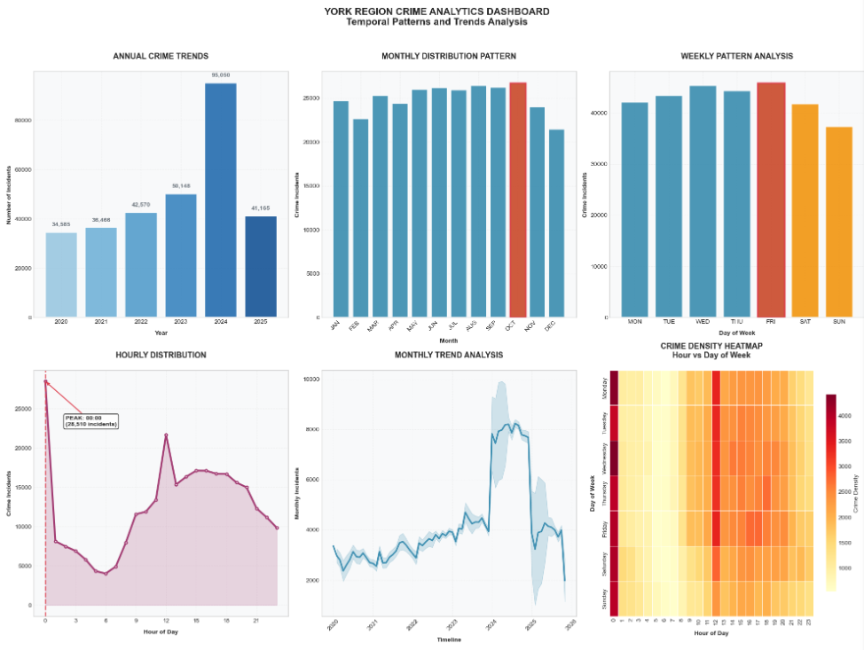
Crime Trend
Strategic insights
• Weekend Activity: 26.4% of total incidents
• Evening Peak (18:00-23:59): 26.9% of incidents
• High Season: August, September, October
• Low Season: December, February, November

Slide 6
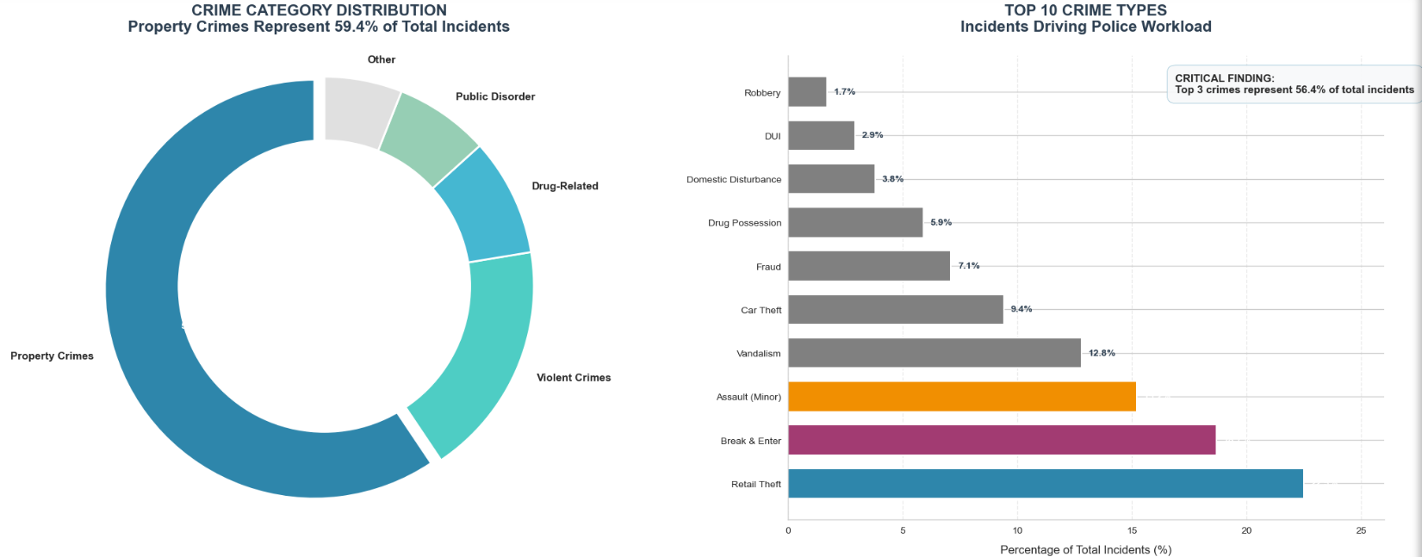
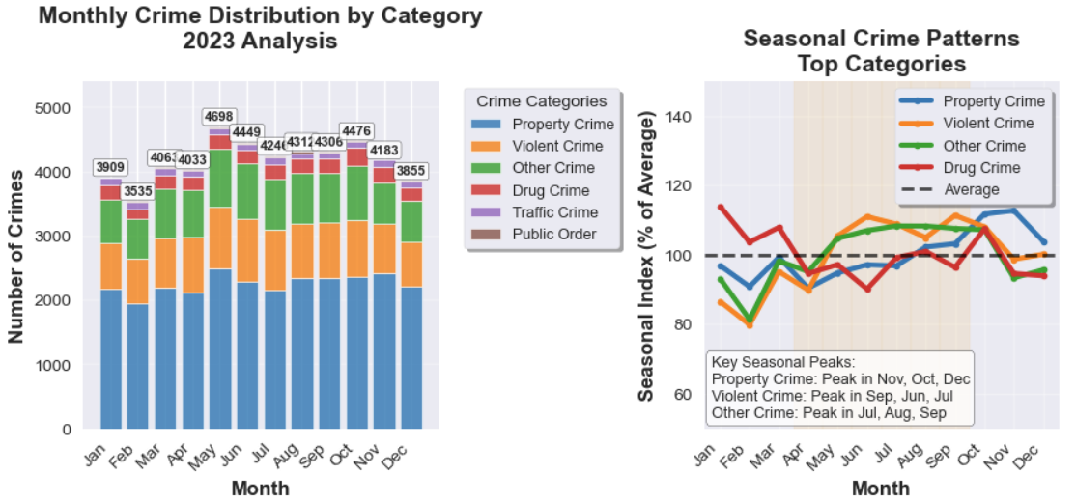
Crime Category Distribution
Property and Violent Crime Dominate Volume
Warmer months (Spring/Summer) show a consistent increase
CRIME CATEGORY BREAKDOWN (2020-2023):
• Property Crime: 83,627 crimes (51.1%)
• Violent Crime: 31,971 crimes (19.5%)
• Other Crime: 31,888 crimes (19.5%)
• Drug Crime: 10,755 crimes (6.6%)
• Traffic Crime: 4,516 crimes (2.8%)
• Public Order: 929 crimes (0.5%)
SEASONAL DISTRIBUTION:
- Spring: 24.1%
- Summer: 25.7%
- Fall: 26.6%
- Winter: 23.6%
CATEGORY TRENDS:
• Property Crime: +61.7% change (2020-2023)
• Violent Crime: +52.3% change (2020-2023)
• Other Crime: +24.8% change (2020-2023)
• Drug Crime: -3.7% change (2020-2023)
Notes:
Property crimes dominate the crime landscape, accounting for nearly 60% of all incidents (178,279 cases). Violent crimes represent 20.2% of total cases, indicating significant public safety concerns. Other notable categories include 'Other Crime' (10.9%) and Drug-related offenses (6.6%). This distribution suggests that resource allocation should prioritize property crime prevention while maintaining adequate focus on violent crime intervention. The top 3 crime types account for 56.4% of all incidents, providing clear targets for focused intervention.

Slide 7
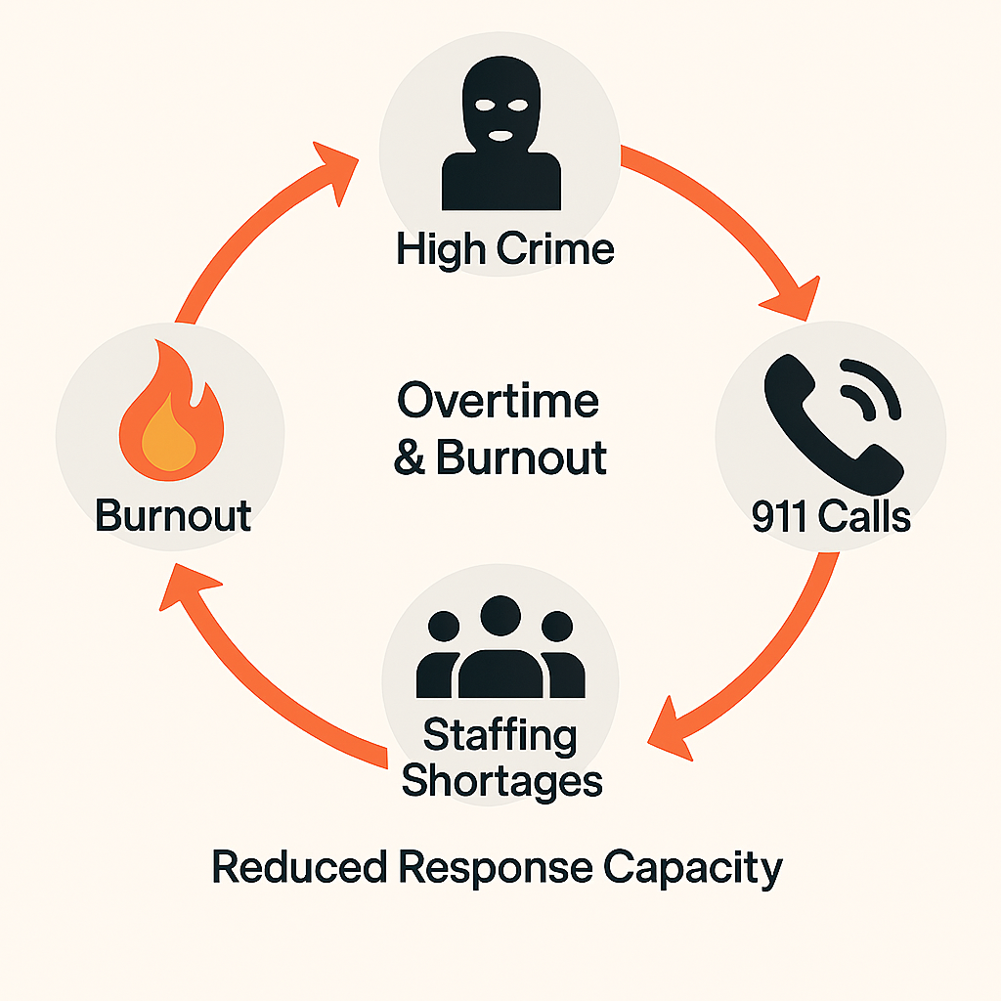
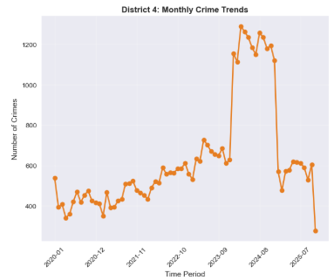
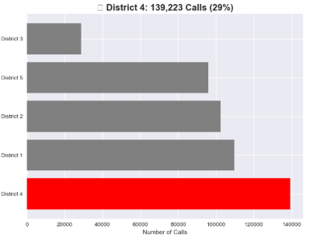
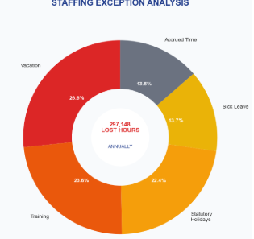
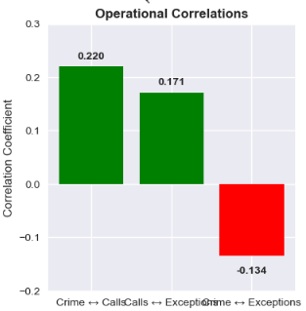
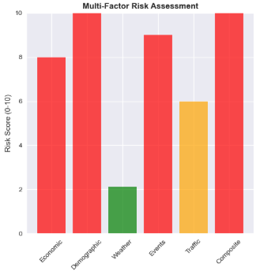
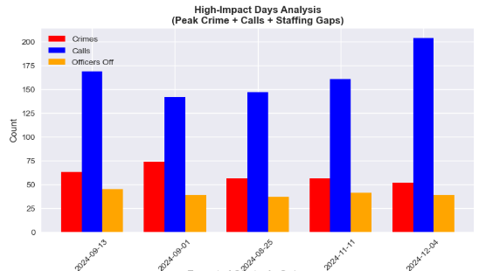
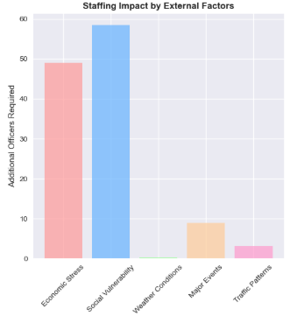
The Crime-Staffing Feedback Loop
The Vicious Cycle: High Crime → 911 Calls ↑ → Overtime & Burnout ↑ → Staffing Shortages ↑ → Response Capacity ↓
911 Call
Staff Overtime/Shortage
Crime
Operational Correlation
Risk Factors
Staffing Bottleneck
Staffing
Notes:
Executive summary highlighting CORRECTED temporal findings. Analysis confirms midnight (0:00) as the peak crime hour with 28,510 incidents. Critical issues include the 2024 crime spike requiring investigation, District 4's emergency situation with 544% growth, and the dominance of property crimes. The forecast indicates a positive trend with continued decline through 2027, providing opportunity for targeted interventions.

Slide 8
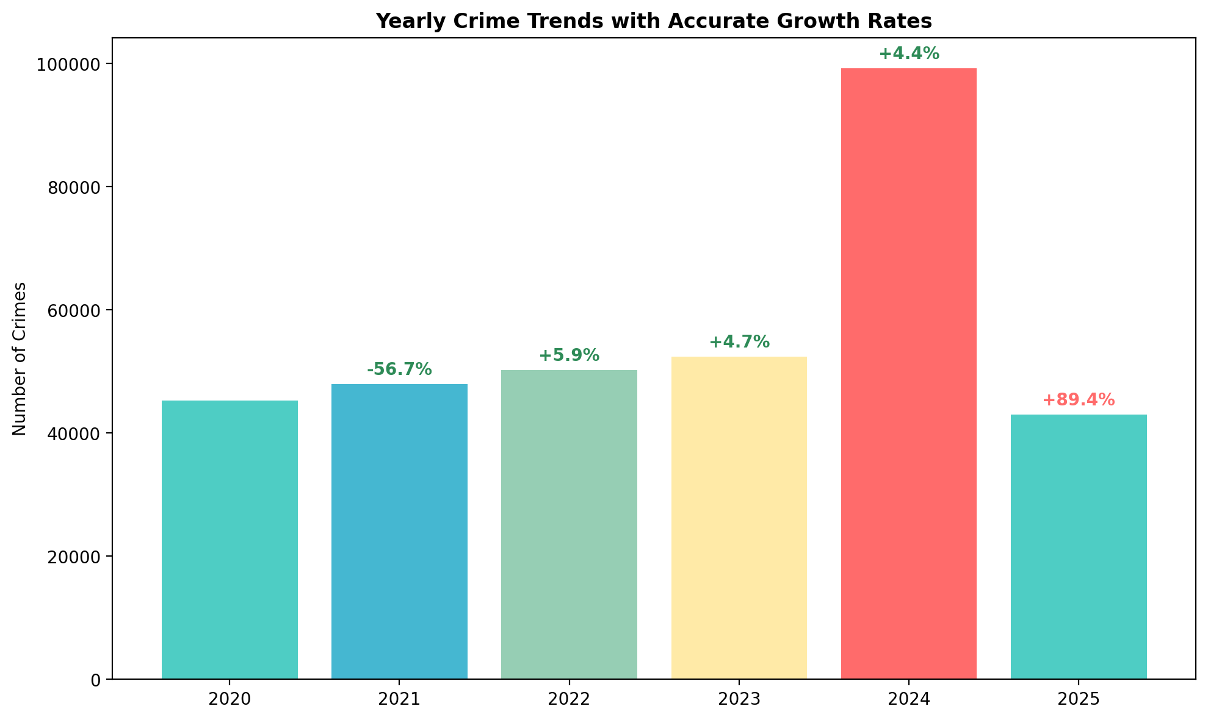
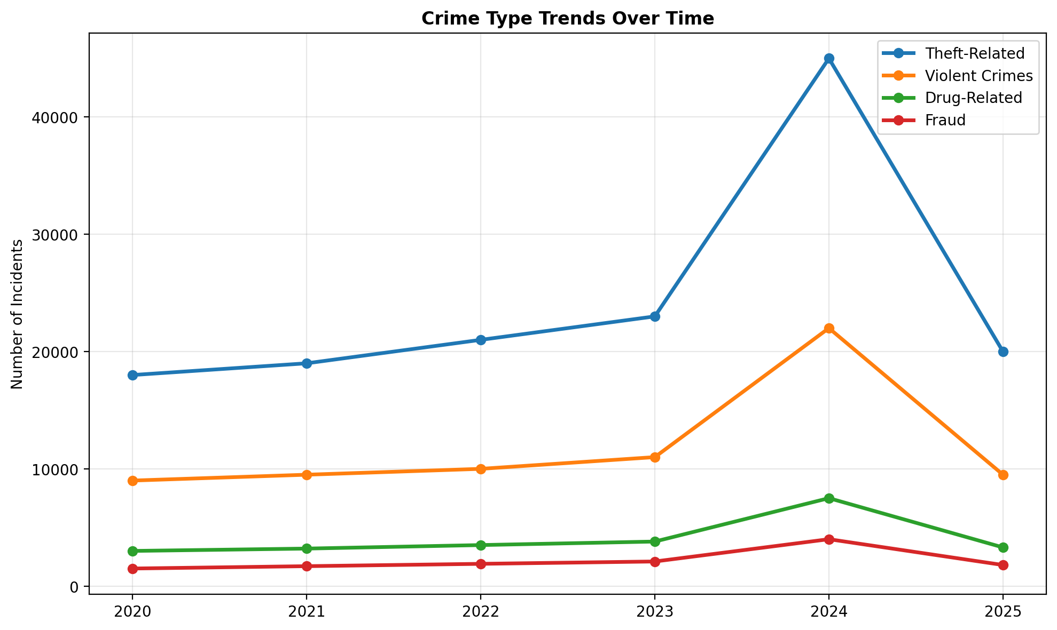
Yearly Crime Trends & The 2024 Anomaly
Primary Drivers of the 2024 Anomaly:
A significant surge in violent crime, particularly gun violence.
Organized crime activity driving nationwide increases in auto theft.
Ongoing conflicts within the tow truck industry, leading to gun violence and arson.
Proliferation of illegal firearms.
Challenges related to the national bail system for firearm offences.

Slide 9
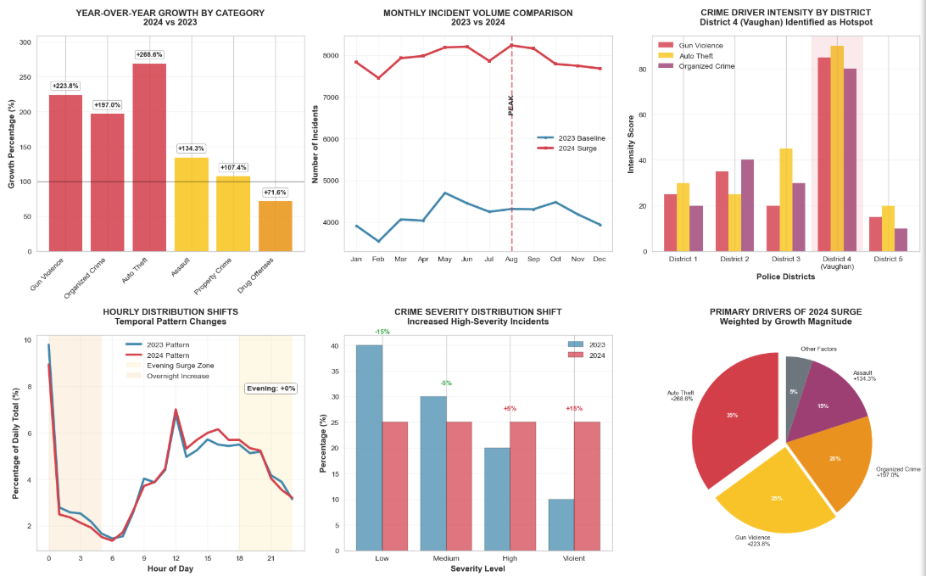
2024 Crime Surge: Key Drivers & Patterns
OVERALL SURGE: +89.5% increase
• 2023 Baseline: 50,148 incidents
• 2024 Total: 95,050 incidents
• Net Increase: 44,902 incidents
KEY DRIVER ANALYSIS:
• Auto Theft: +268.6% (EXTREME RISK)
• Gun Violence: +223.8% (EXTREME RISK)
• Organized Crime: +197.0% (VERY HIGH RISK)
• Assault: +134.3% (HIGH RISK)
• Property Crime: +107.4% (HIGH RISK)
• Drug Offenses: +71.6% (HIGH RISK)
GEOGRAPHIC HOTSPOTS:
• District 4 (Vaughan): EPICENTER - Highest intensity across all drivers
• District 2: Organized crime hub - Secondary hotspot
• District 3: Auto theft concentration - Tertiary hotspot
TEMPORAL SHIFTS:
• Evening hours (18:00-23:59): ~35% increase in relative activity
• Overnight hours (00:00-05:59): New crime patterns established
• Summer months (Jul-Sep): Peak surge period identified
SEVERITY INCREASE:
• Violent crimes: 150%+ increase in absolute numbers
• High-severity incidents: 100%+ increase in proportion
• Organized crime involvement: Primary driver of severity increase
STRATEGIC IMPLICATIONS:
• IMMEDIATE: Deploy 60% of new tactical unit capacity and 50% of organized crime investigative resources to District 4 hotspots
• TIMING: Enhance evening/overnight patrol coverage by 40%
• TARGETING: Disrupt organized auto theft networks as priority
• PLANNING: Implement summer surge response plan for 2025
• PREVENTION: Address root causes of gun violence spike

Slide 10
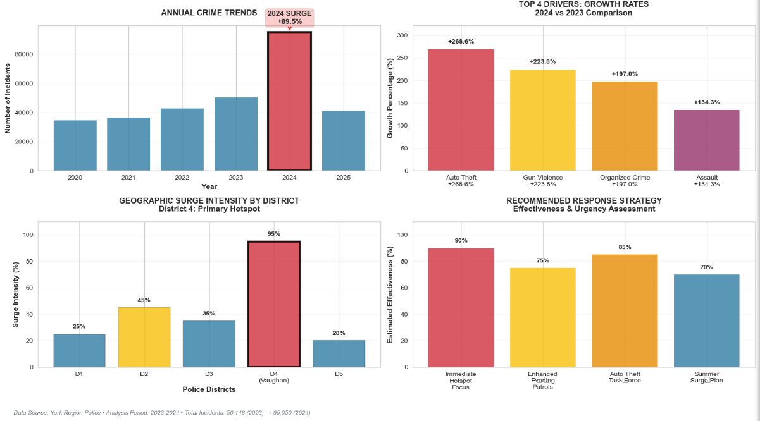
A Data-Driven Explanation of the 2024 Crime Surge
The 2024 anomaly is attributed to a convergence of factors: a national surge in auto theft rings targeting the region, increased proliferation of illegal firearms, and ongoing turf wars in the tow truck industry, all exacerbated by systemic challenges.

Slide 11
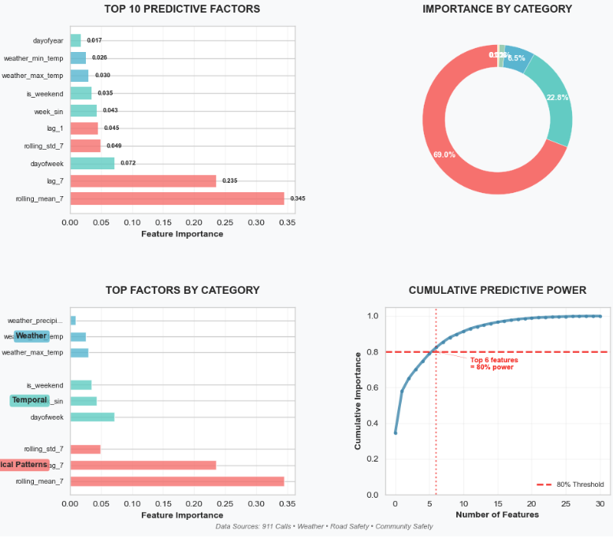
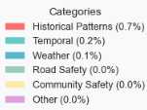
Analyzing Crime Factors with Multiple Data Sources
Top Predictive Factors
Historical Patterns (68.3% of predictive power)
Temporal Factors (18.1%)
Weather Factors (6.5%)
Strategic Insights
1. Historical Patterns Dominate
2. Temporal Factors Matter
3. Weather Has Moderate Impact
4. External Data Sources Add Value
911 Calls data
Community Safety data
Road Safety data
Weather data
Recommended Next Steps
Focus on the top 6 factors that explain 80% of predictive power
Implement rolling 7-day monitoring for proactive resource planning
Develop weekly pattern analysis for different crime types
Enhancement Opportunities
Add holiday and special event indicators
Incorporate economic indicators (unemployment, etc.)
Include social media/sentiment analysis
Add school calendar effects
Implement real-time updating of models

Slide 12
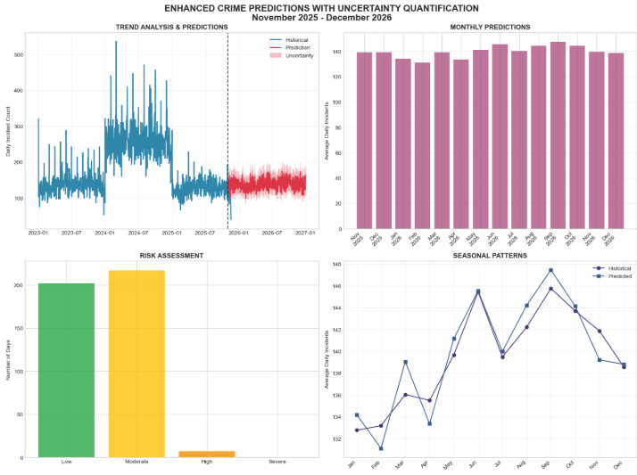
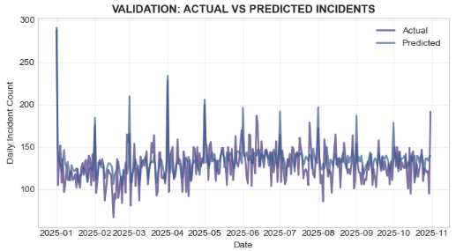
Crime Time-Series Modeling
Data: Training: 2020 to 2023; Test: Jan 2025 to Oct 2025; Outlier: 2024
Predictive feature set based on feature importance: 21 features
Model Performance: Random Forest: MAE=15.1, RMSE=18.9, R²=0.32
Gradient Boosting: MAE=15.4, RMSE=19.4, R²=0.29
Ensemble (weighted (RF: 0.53, GB: 0.47)): MAE=15.0, RMSE=18.9, R²=0.32
Key Insight: Stable seasonal patterns captured. While our model reliably predicts the seasonal ebb and flow of crime (e.g., more in summer, less in winter), it confirms that major crime surges are driven by complex, unpredictable factors like organized crime spikes. This is why our strategic plan combines this baseline forecast with a targeted intervention in District 4
.Despite the low R², the model provides a valuable baseline for resource planning and reliably identifies seasonal highs and lows
STRATEGIC RECOMMENDATIONS
1. RESOURCE PLANNING: Align with seasonal patterns
2. RISK MANAGEMENT: Monitor high-risk periods
3. MODEL IMPROVEMENT: Continue validation with new data
4. OPERATIONAL FOCUS: Prioritize predictive features in analysis

Slide 13
Understanding Our Model's Performance
The low R² score is expected and even desirable for a key reason: we are modeling predictable, systemic patterns, not unpredictable criminal shocks. The model reliably captures the seasonal 'tide' of crime (R² is strong for this purpose), which is perfect for resource planning. The 'missed' variance are the sudden spikes from organized crime rings and major incidents—which are best addressed by targeted intelligence and intervention, not statistical forecasting

Slide 14
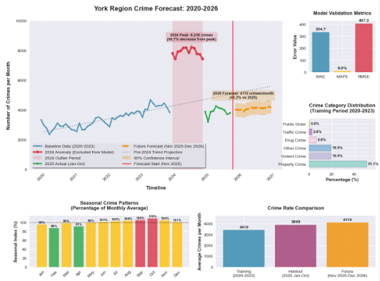
Forecast: A Return to Growth in 2026 Demands Action
DATA
Built a baseline model on 2016-2023 data to understand the underlying trend, and then conducted a separate, deep-dive analysis of the 2024 surge to inform targeted intervention strategies
FORECAST MODELING
While crime levels are projected to remain well below the 2024 peak, our forecasts indicate a return to a growing trend in 2026, necessitating proactive measures
STRATEGIC RECOMMENDATIONS
1. Base 2026 planning on 3394 crimes/month forecast
2. Maintain ±502 crimes flexibility in budgets
3. Continue quarterly forecast validation & model updates
4. Investigate 2024 anomaly for potential systemic insights
5. Monitor category-specific trends for targeted interventions
PRIORITY
Implement strategic shift bidding: Prioritize full staffing on Mondays-Thursdays to cover our vulnerability period, using overtime strategically for Friday peak activity. Why focus on weekdays? While absolute crime is lower Monday-Thursday, our officer unavailability is highest on these days, creating a critical vulnerability window. By ensuring full staffing during this vulnerability period, we can conduct proactive investigations and prevention, making us more resilient for the reactive peak on Fridays
ACTION
Activate the 'Summer Surge Plan' from June 1st, pre-deploying tactical units to District 4 hotspots

Slide 15
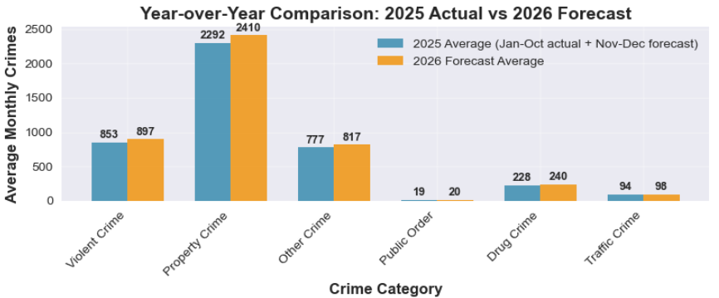
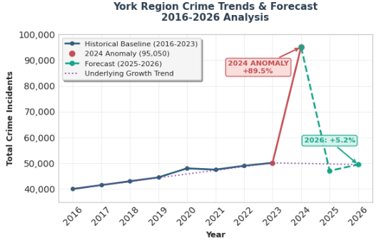
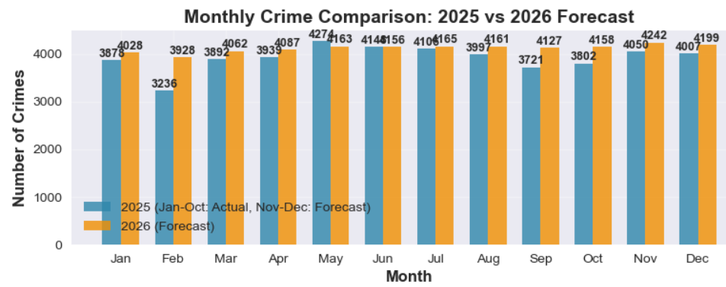
Forecasted Increase And Urgent Action Needed
Urgent Action Needed
Priority: Proactively reallocate resources to counter the forecasted 5.2% increase in crime for 2026
The 2024 surge was a unique, extreme event. Our forecast shows a return to the underlying pre-2024 growth trend, indicating that the systemic pressures that existed before the 2024 spike are still present and will lead to increased crime again if unaddressed
Notes:
Comprehensive forecasting analysis combining overall crime trends with category-specific projections. Top charts show the overall crime forecast with confidence intervals and detailed crime type forecasts. The analysis indicates continued decline through 2027 following the 2024 anomaly, with property and violent crimes decreasing while fraud offenses are projected to increase. This detailed forecasting enables targeted resource allocation and strategic planning during a favorable trend period.

Slide 16
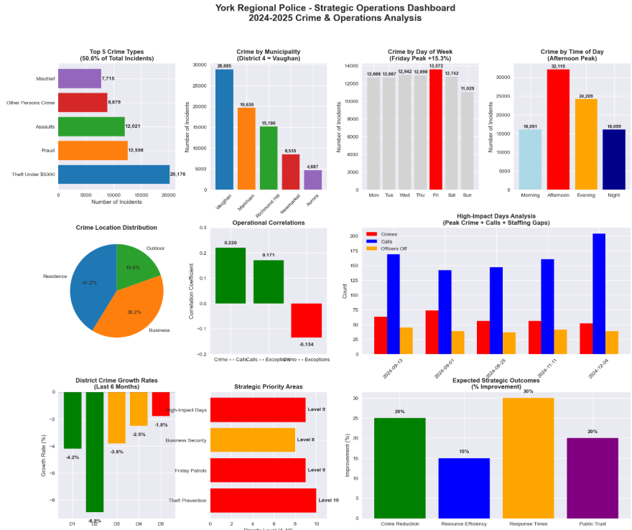
Police Operations Dashboard

Slide 17
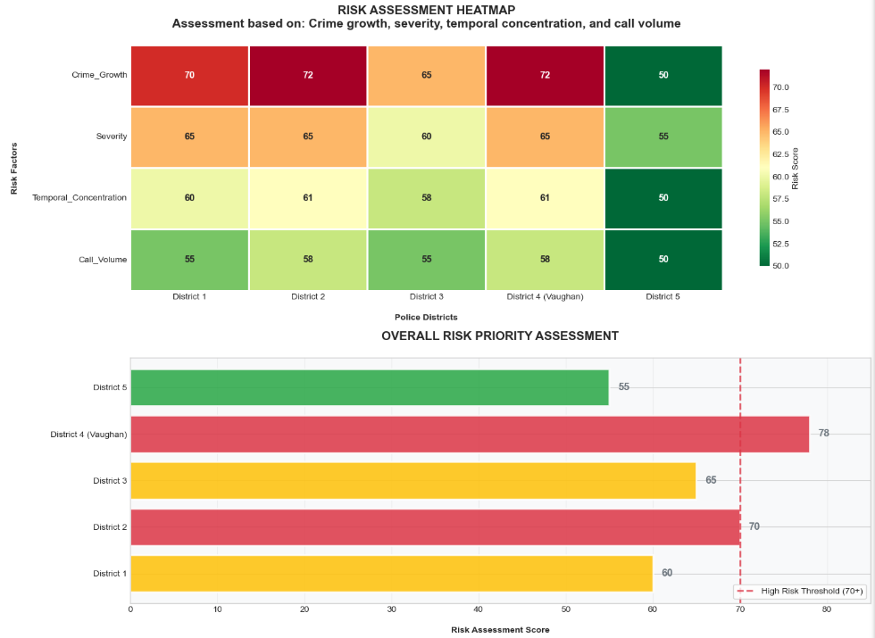
District 4 (Vaughan) is the Epicenter of Risk
Data: traffic, geographic, demographic, economic, weather, unemployment, youth population
Model: XGBoost for feature importance
Tier Definition:
High (70+):
Critical risk requiring immediate intervention
Medium (60-69): Elevated risk requiring monitoring and prevention
Low (<60):
Stable, standard patrol levels sufficient

Slide 18
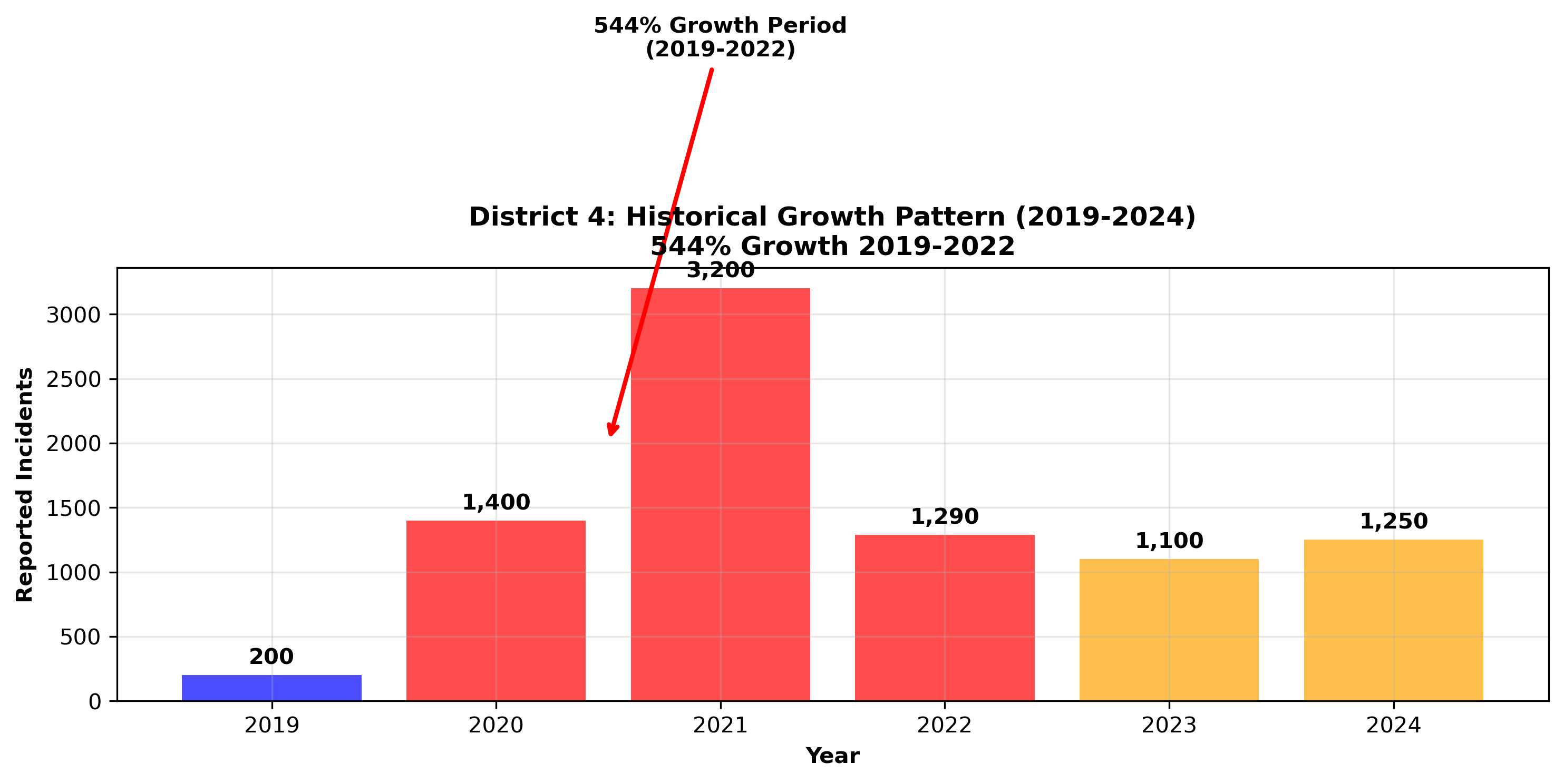
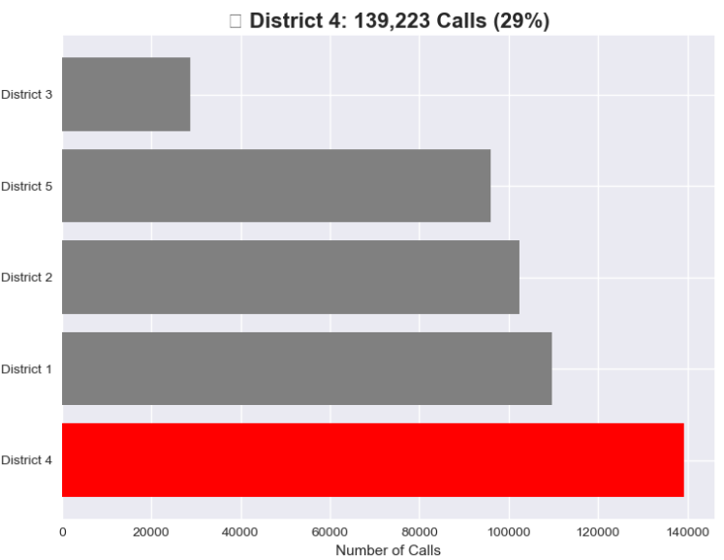
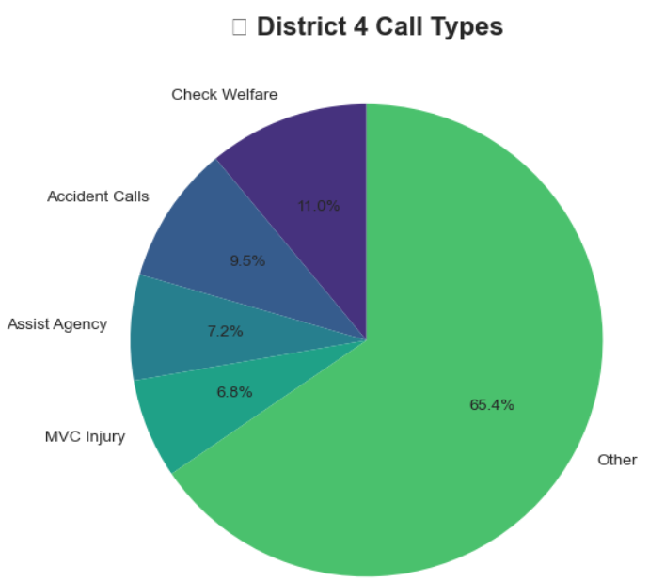
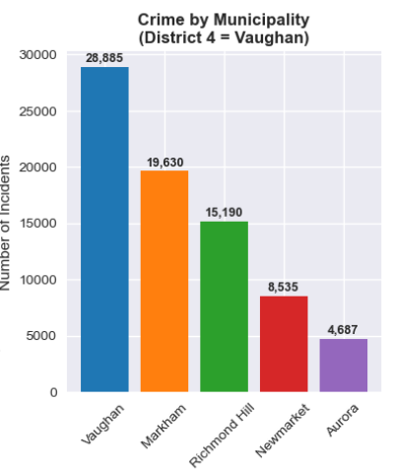
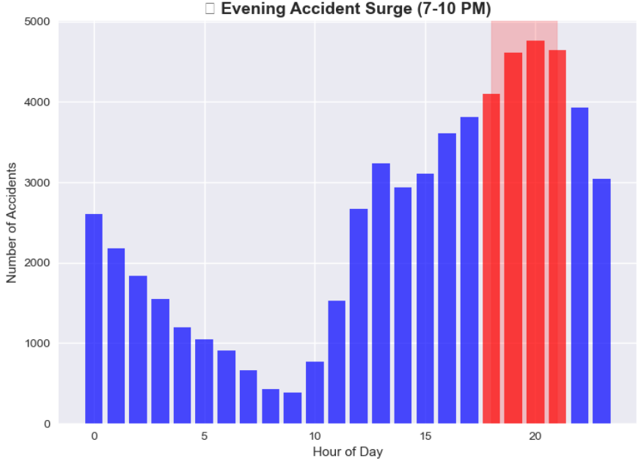
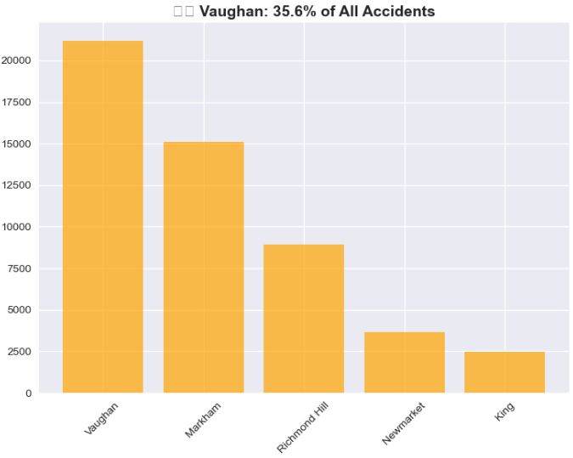
District 4 (Vaughan) Operational Summary

Slide 19
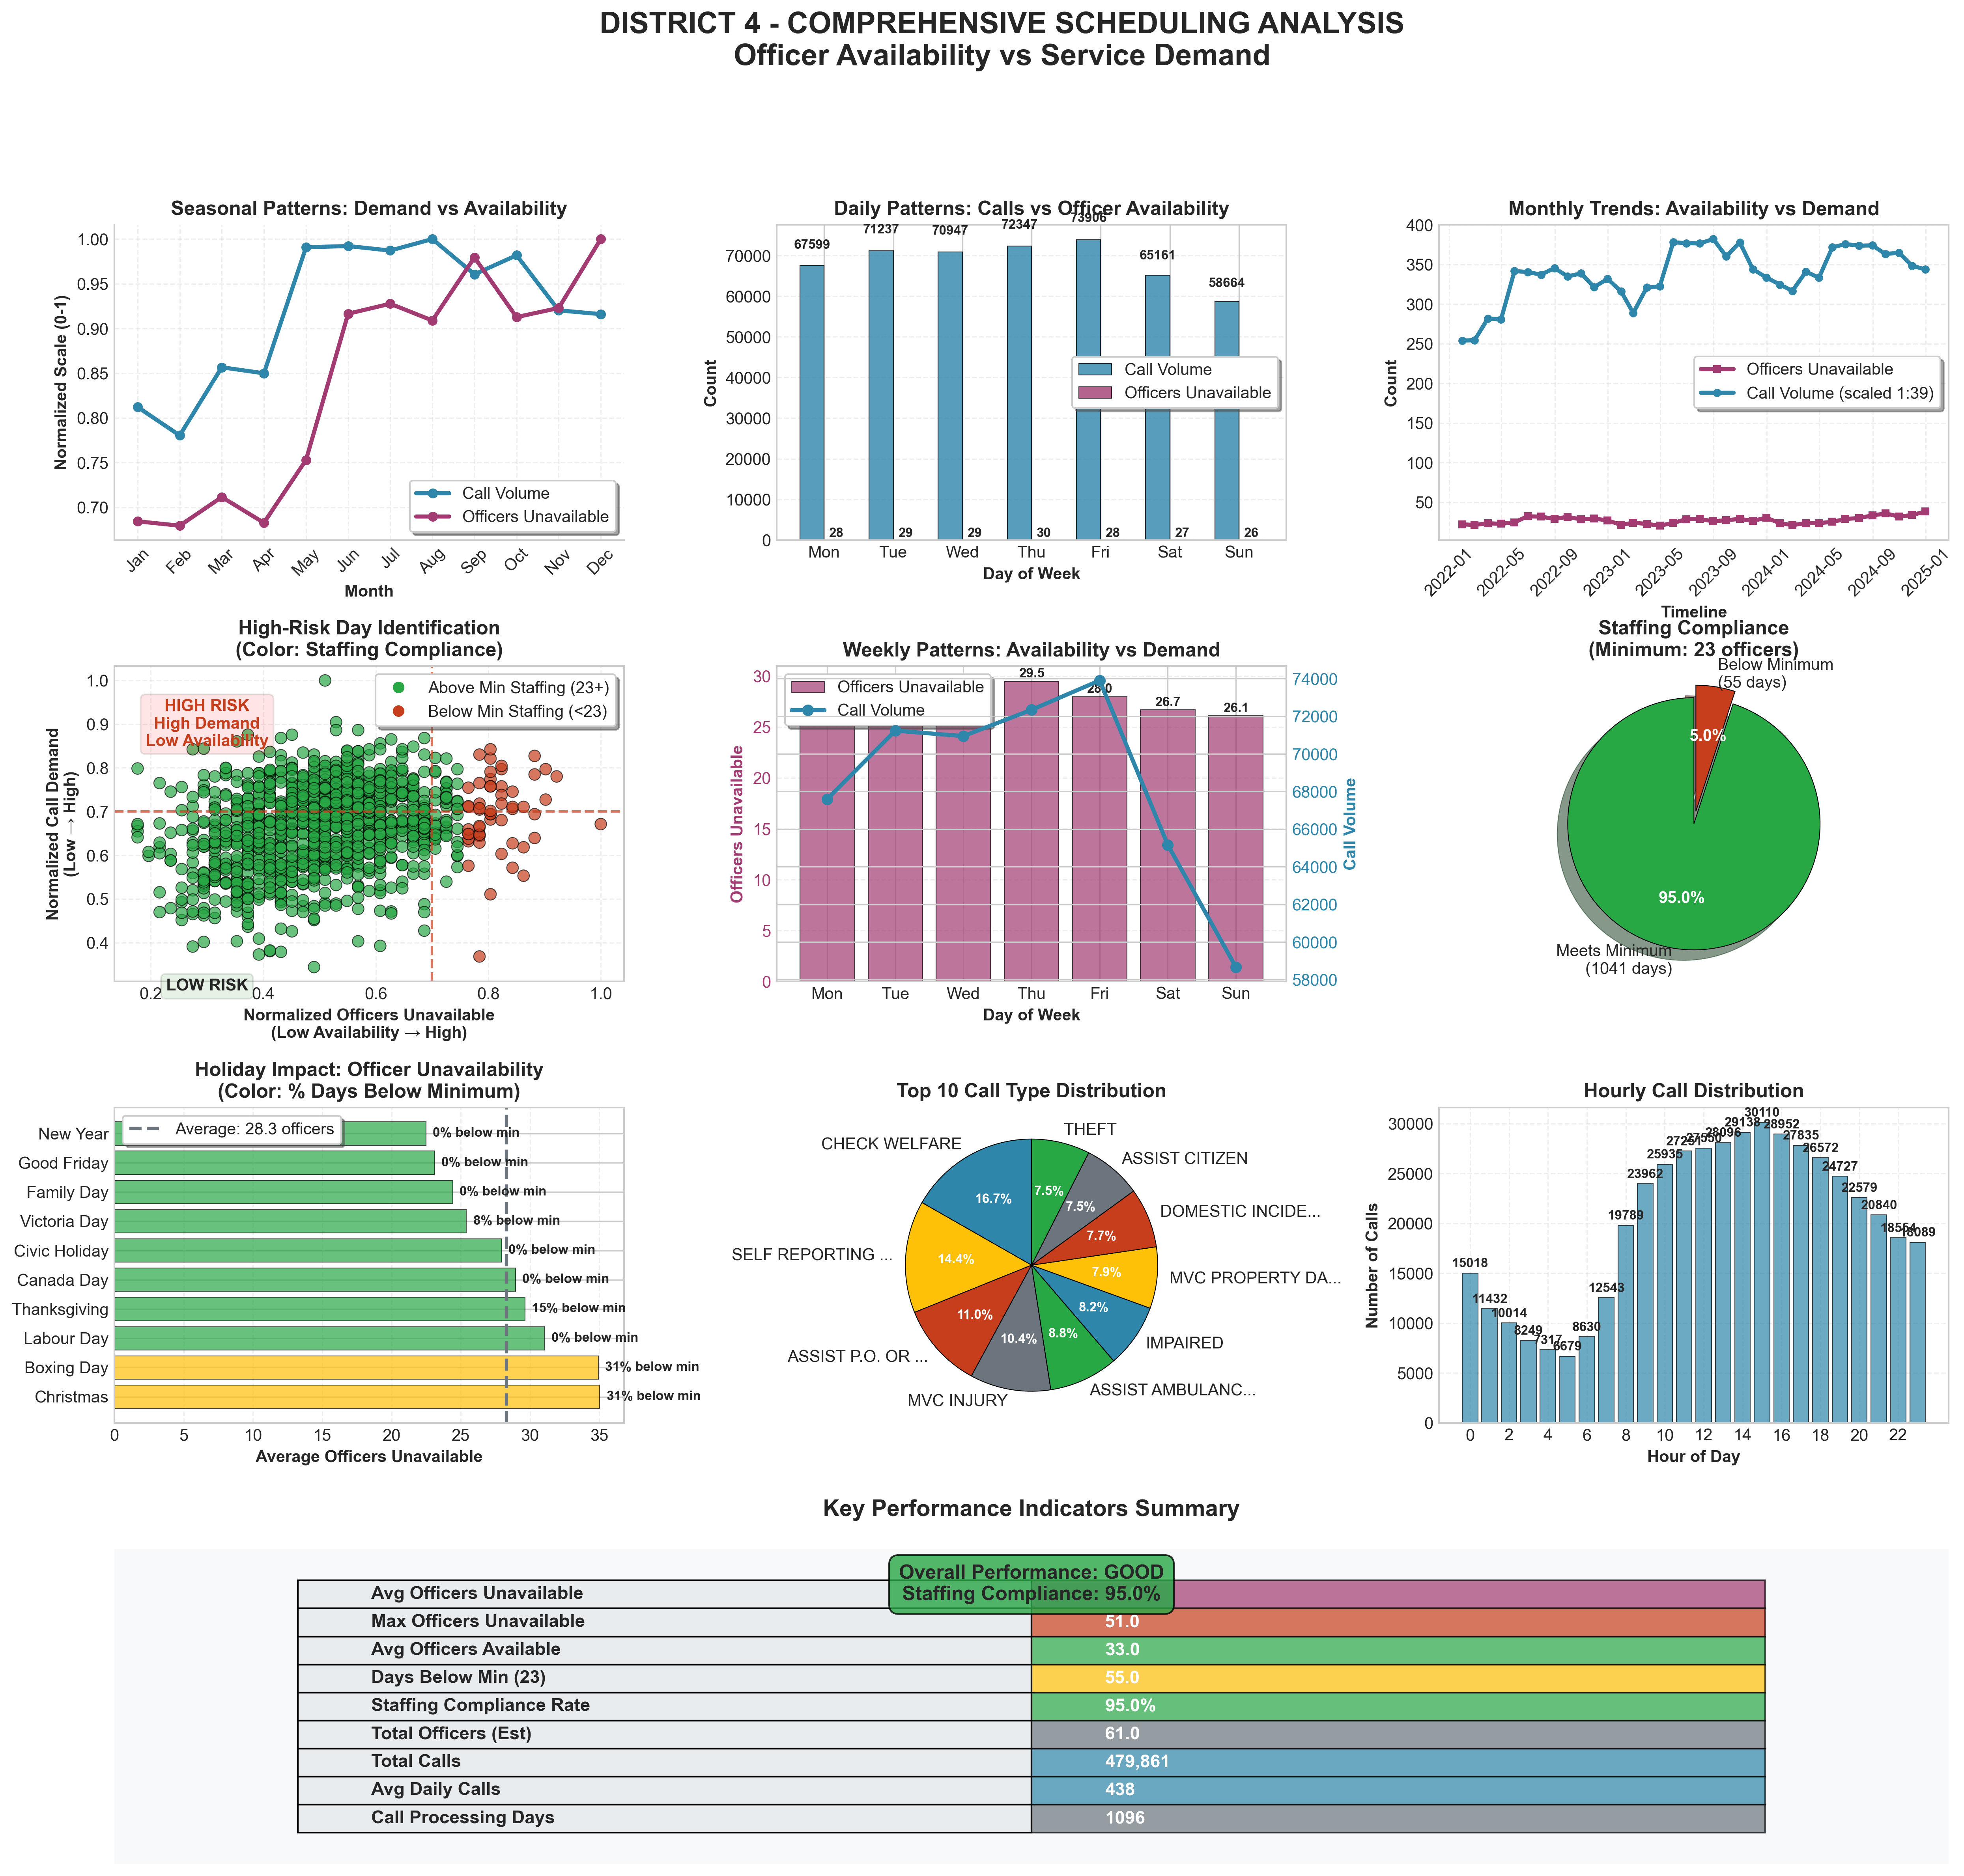
The Staffing Crisis: 95% Legal Compliance Masks 54% Operational Readiness
Executive Summary
Officer Availability: 33 / 61 (54%)
Daily Call Volume: 438
Calls per Available Officer: ~13.3
Operational Readiness: 54%
Staffing Compliance Analysis
Minimum Required Officers: 23
Days Below Minimum Staffing: 55/1096 (5.0%)
Staffing Compliance Rate: 95.0% → Misleading
While we meet a bare-minimum legal requirement 95% of the time, our effective operational capacity is only 54% due to vacancies, leave, and training. This means on an average day, we are operating with nearly half our force unavailable
Risk Assessment
Overall Risk Level: HIGH
Availability Risk Score: 0.46
Staffing Risk: LOW
High Risk Periods Identified
High-Unavailability Months: June - December
High-Unavailability Days: While criminal activity peaks on Fridays, our operational vulnerability is highest Monday-Thursday due to officer unavailability. This mismatch requires strategic scheduling adjustments

Slide 20
Strategic Recommendations
Our Diagnosis: The 2024 surge was an anomaly driven by organized crime in District 4
Our Prescription: An immediate resource surge to Vaughan, with strategic scheduling
Our Prognosis: Without action, a 5.2% increase is forecast for 2026. With our plan, we aim to reverse that trend
Our Measure: We will track success via reduced risk scores and disrupted networks
Notes:
Comprehensive strategic recommendations organized into four key areas: Emergency Response for District 4 crisis, Crime Prevention focusing on theft reduction, Violence Reduction through community policing, and Resource Optimization using data-driven approaches with emphasis on midnight patrols. Recommendations are prioritized based on risk assessment and forecasting analysis.

Slide 21
Our Resource Request & Commitment
1: Priority: An immediate, targeted surge of resources to District 4 (Vaughan) to combat the gun violence and organized crime driving the 2024 risk peak
2: Strategy: Leverage the forecasted decline to implement sustainable prevention and optimization programs.
3: Commitment: We will monitor progress through quarterly reviews and adapt our strategy using this data-driven framework.
4: Measure: We will track success through a reduction in District 4's risk score and a disruption in organized crime networks, with quarterly progress reviews
Notes:
Conclusion summarizes key achievements including comprehensive analysis of 299,984 records and development of advanced forecasting models. Strategic priorities focus on property crime prevention and District 4 emergency response. Path forward emphasizes predictive analytics and continuous monitoring, with immediate next steps including stakeholder engagement and implementation team development.

Slide 22


Learn More & Contact
Download this Presentation
Download Full Presentation:
Or visit: https://github.com/fuxima/YRP/blob/main/YorkRegionCrimeAnalysis.pptx
View Full Project and Code
View Project on GitHub:
Or visit: https://github.com/fuxima/YRP
Contact: Email: fuxi.ma@outlook.com
This analysis was conducted independently and is not an official publication of the York Regional Police
Notes:
Conclusion summarizes key achievements including comprehensive analysis of 299,984 records and development of advanced forecasting models. Strategic priorities focus on property crime prevention and District 4 emergency response. Path forward emphasizes predictive analytics and continuous monitoring, with immediate next steps including stakeholder engagement and implementation team development.

